Slide 1
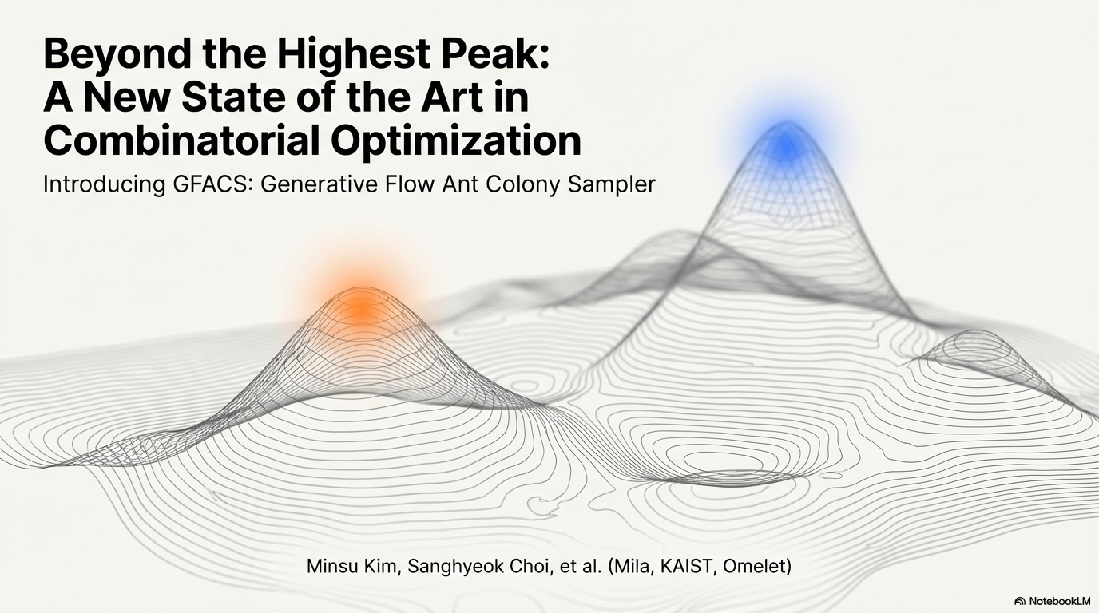
Presenter: Mohammad Javad Najafi
Professor: Dr. Mohammad Mehdi Ebadzadeh

Slide 2
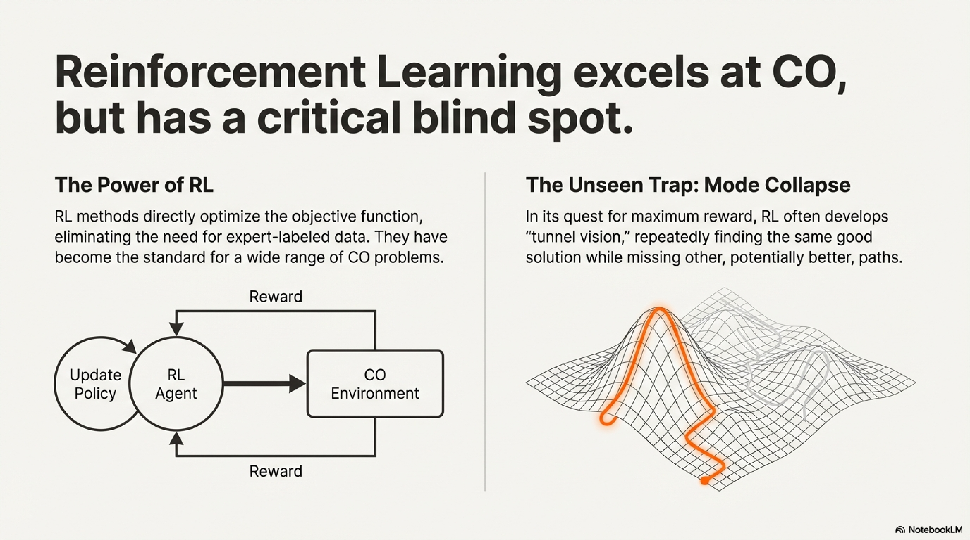

Slide 3
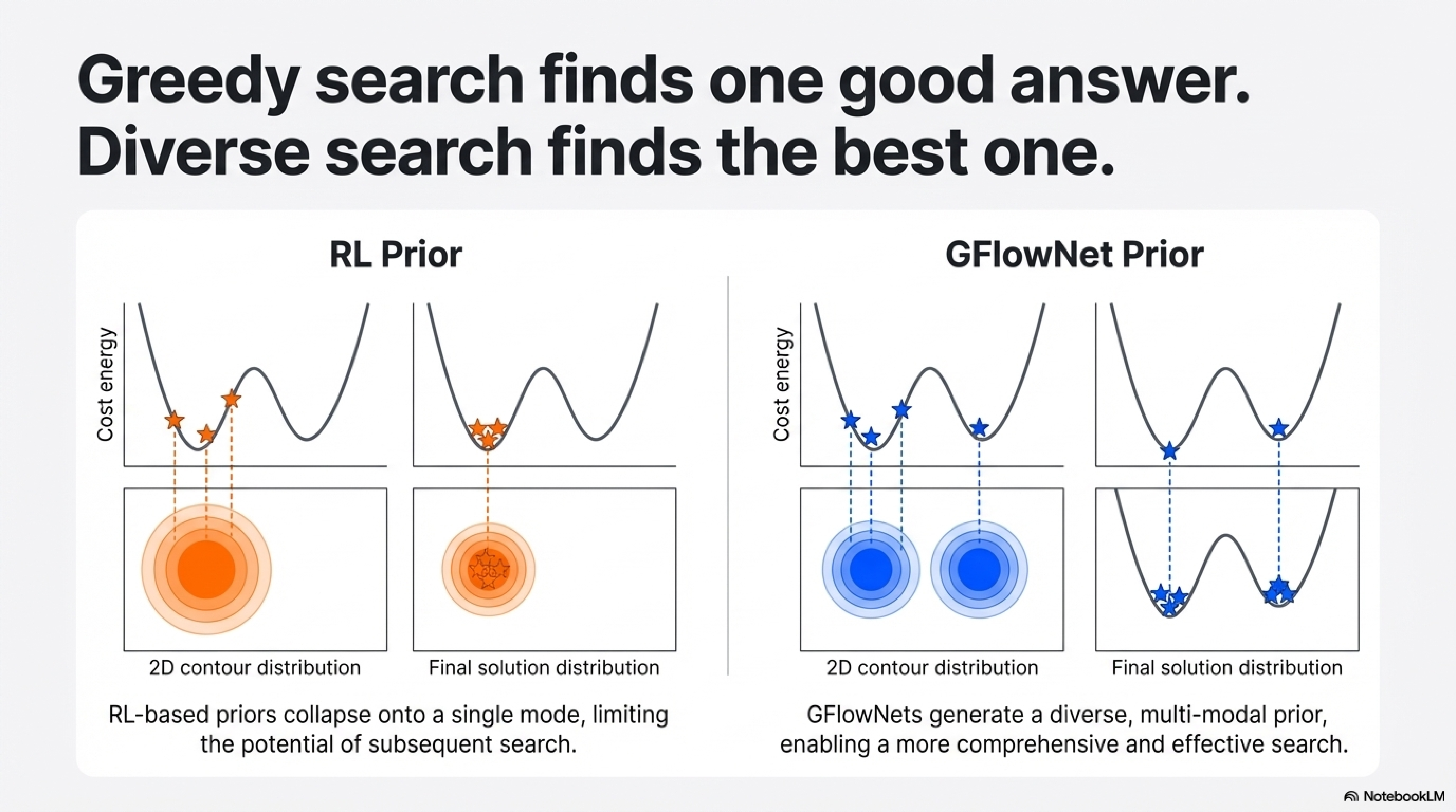

Slide 4
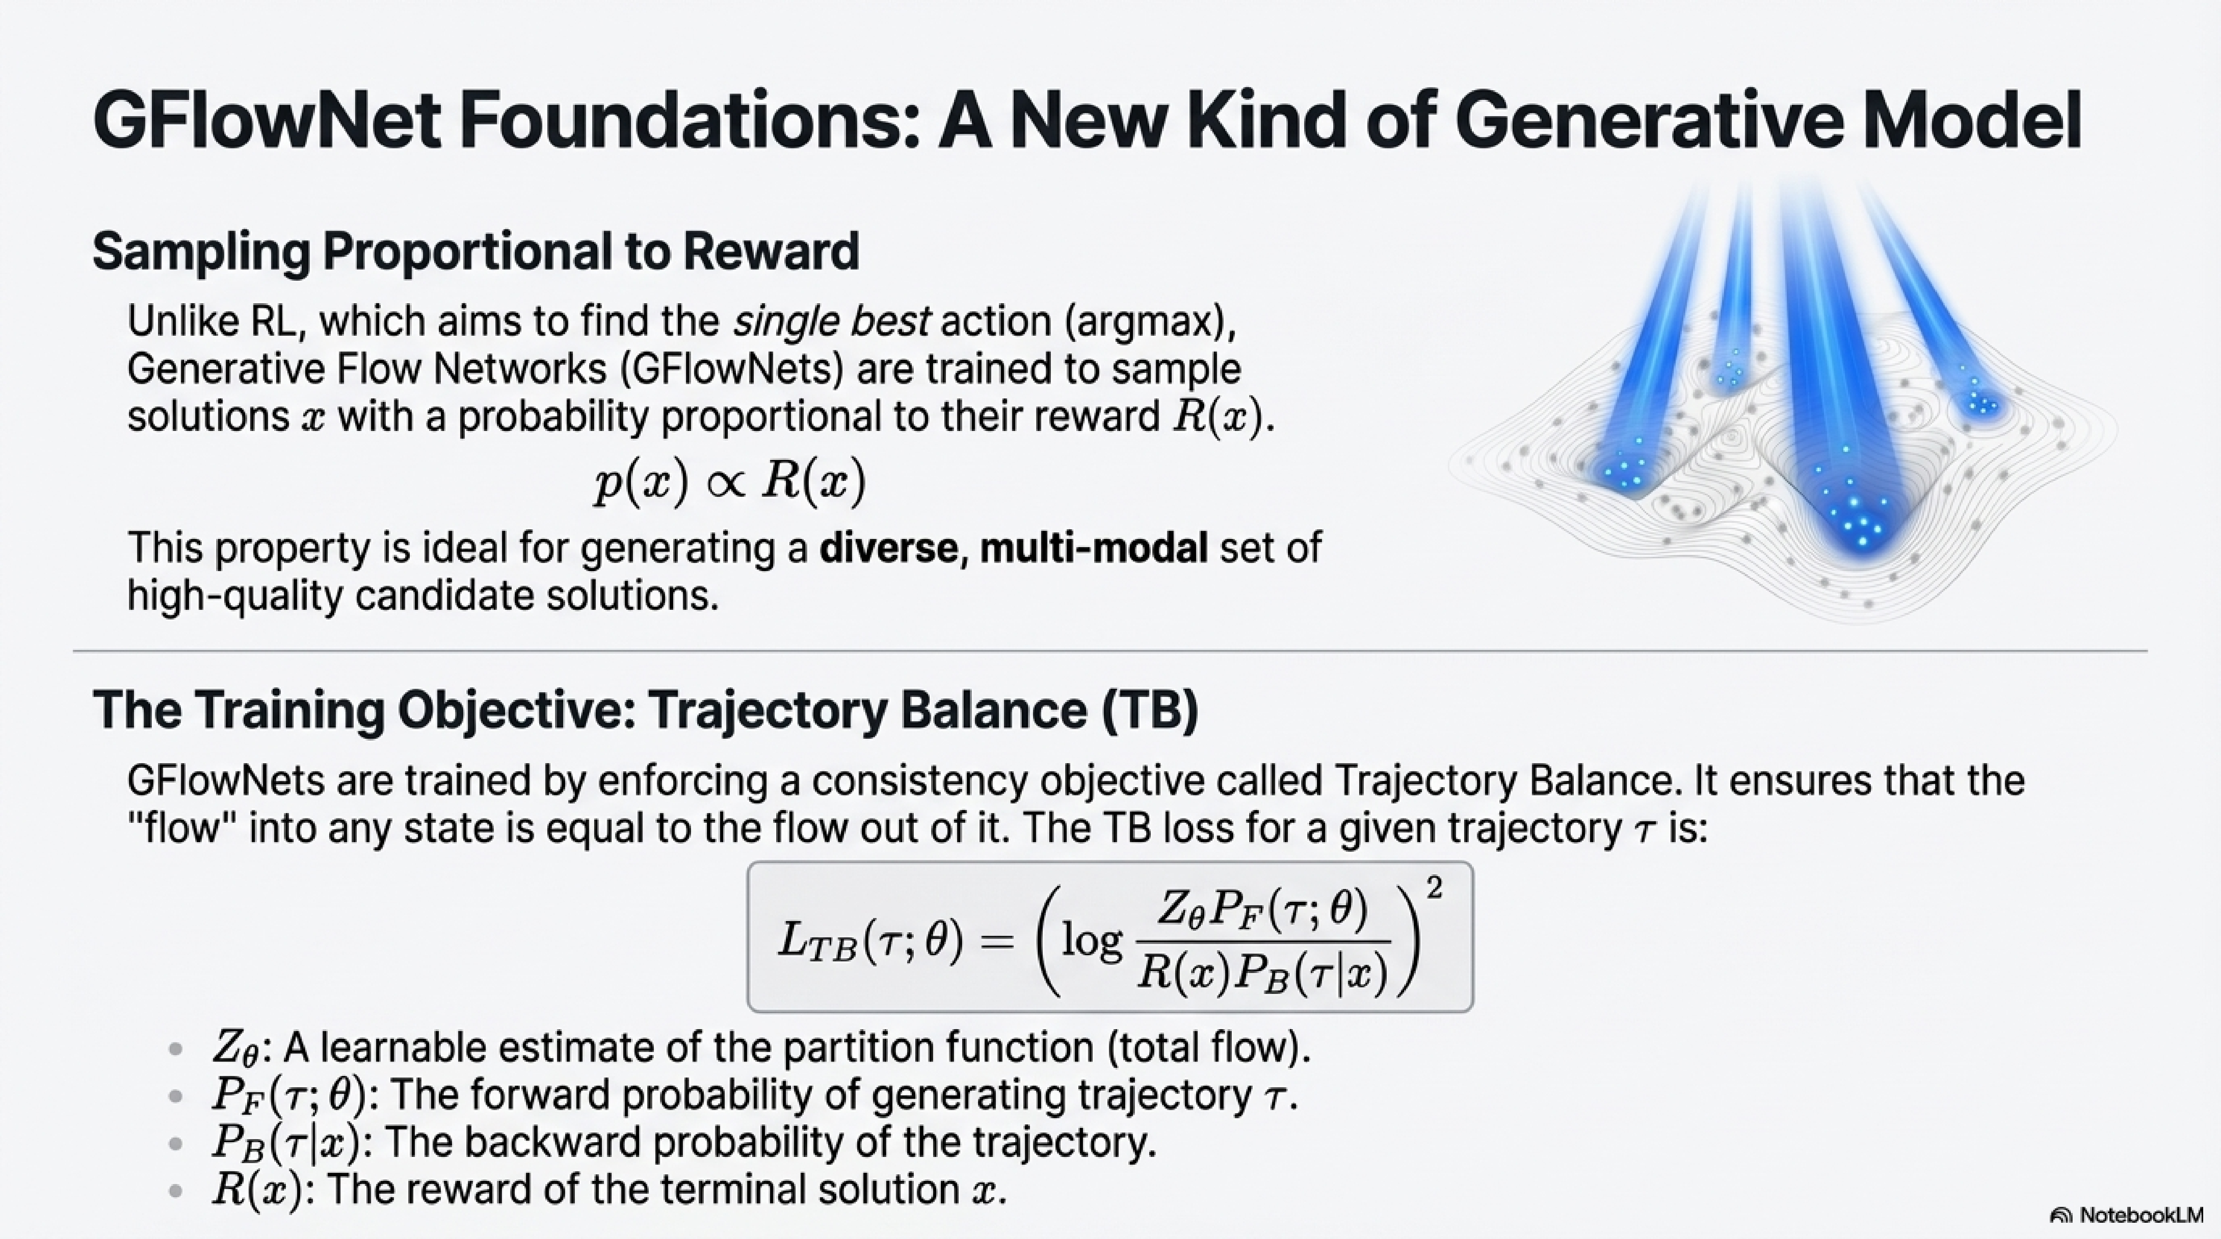

Slide 5
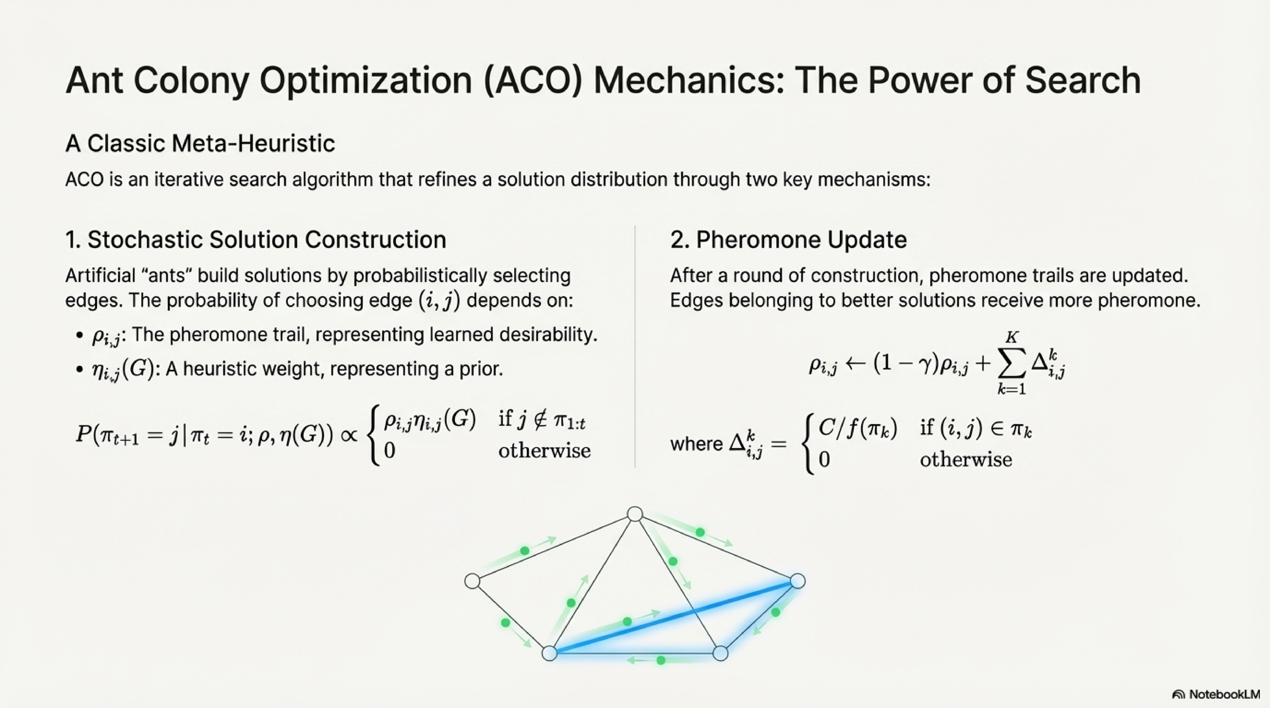

Slide 6
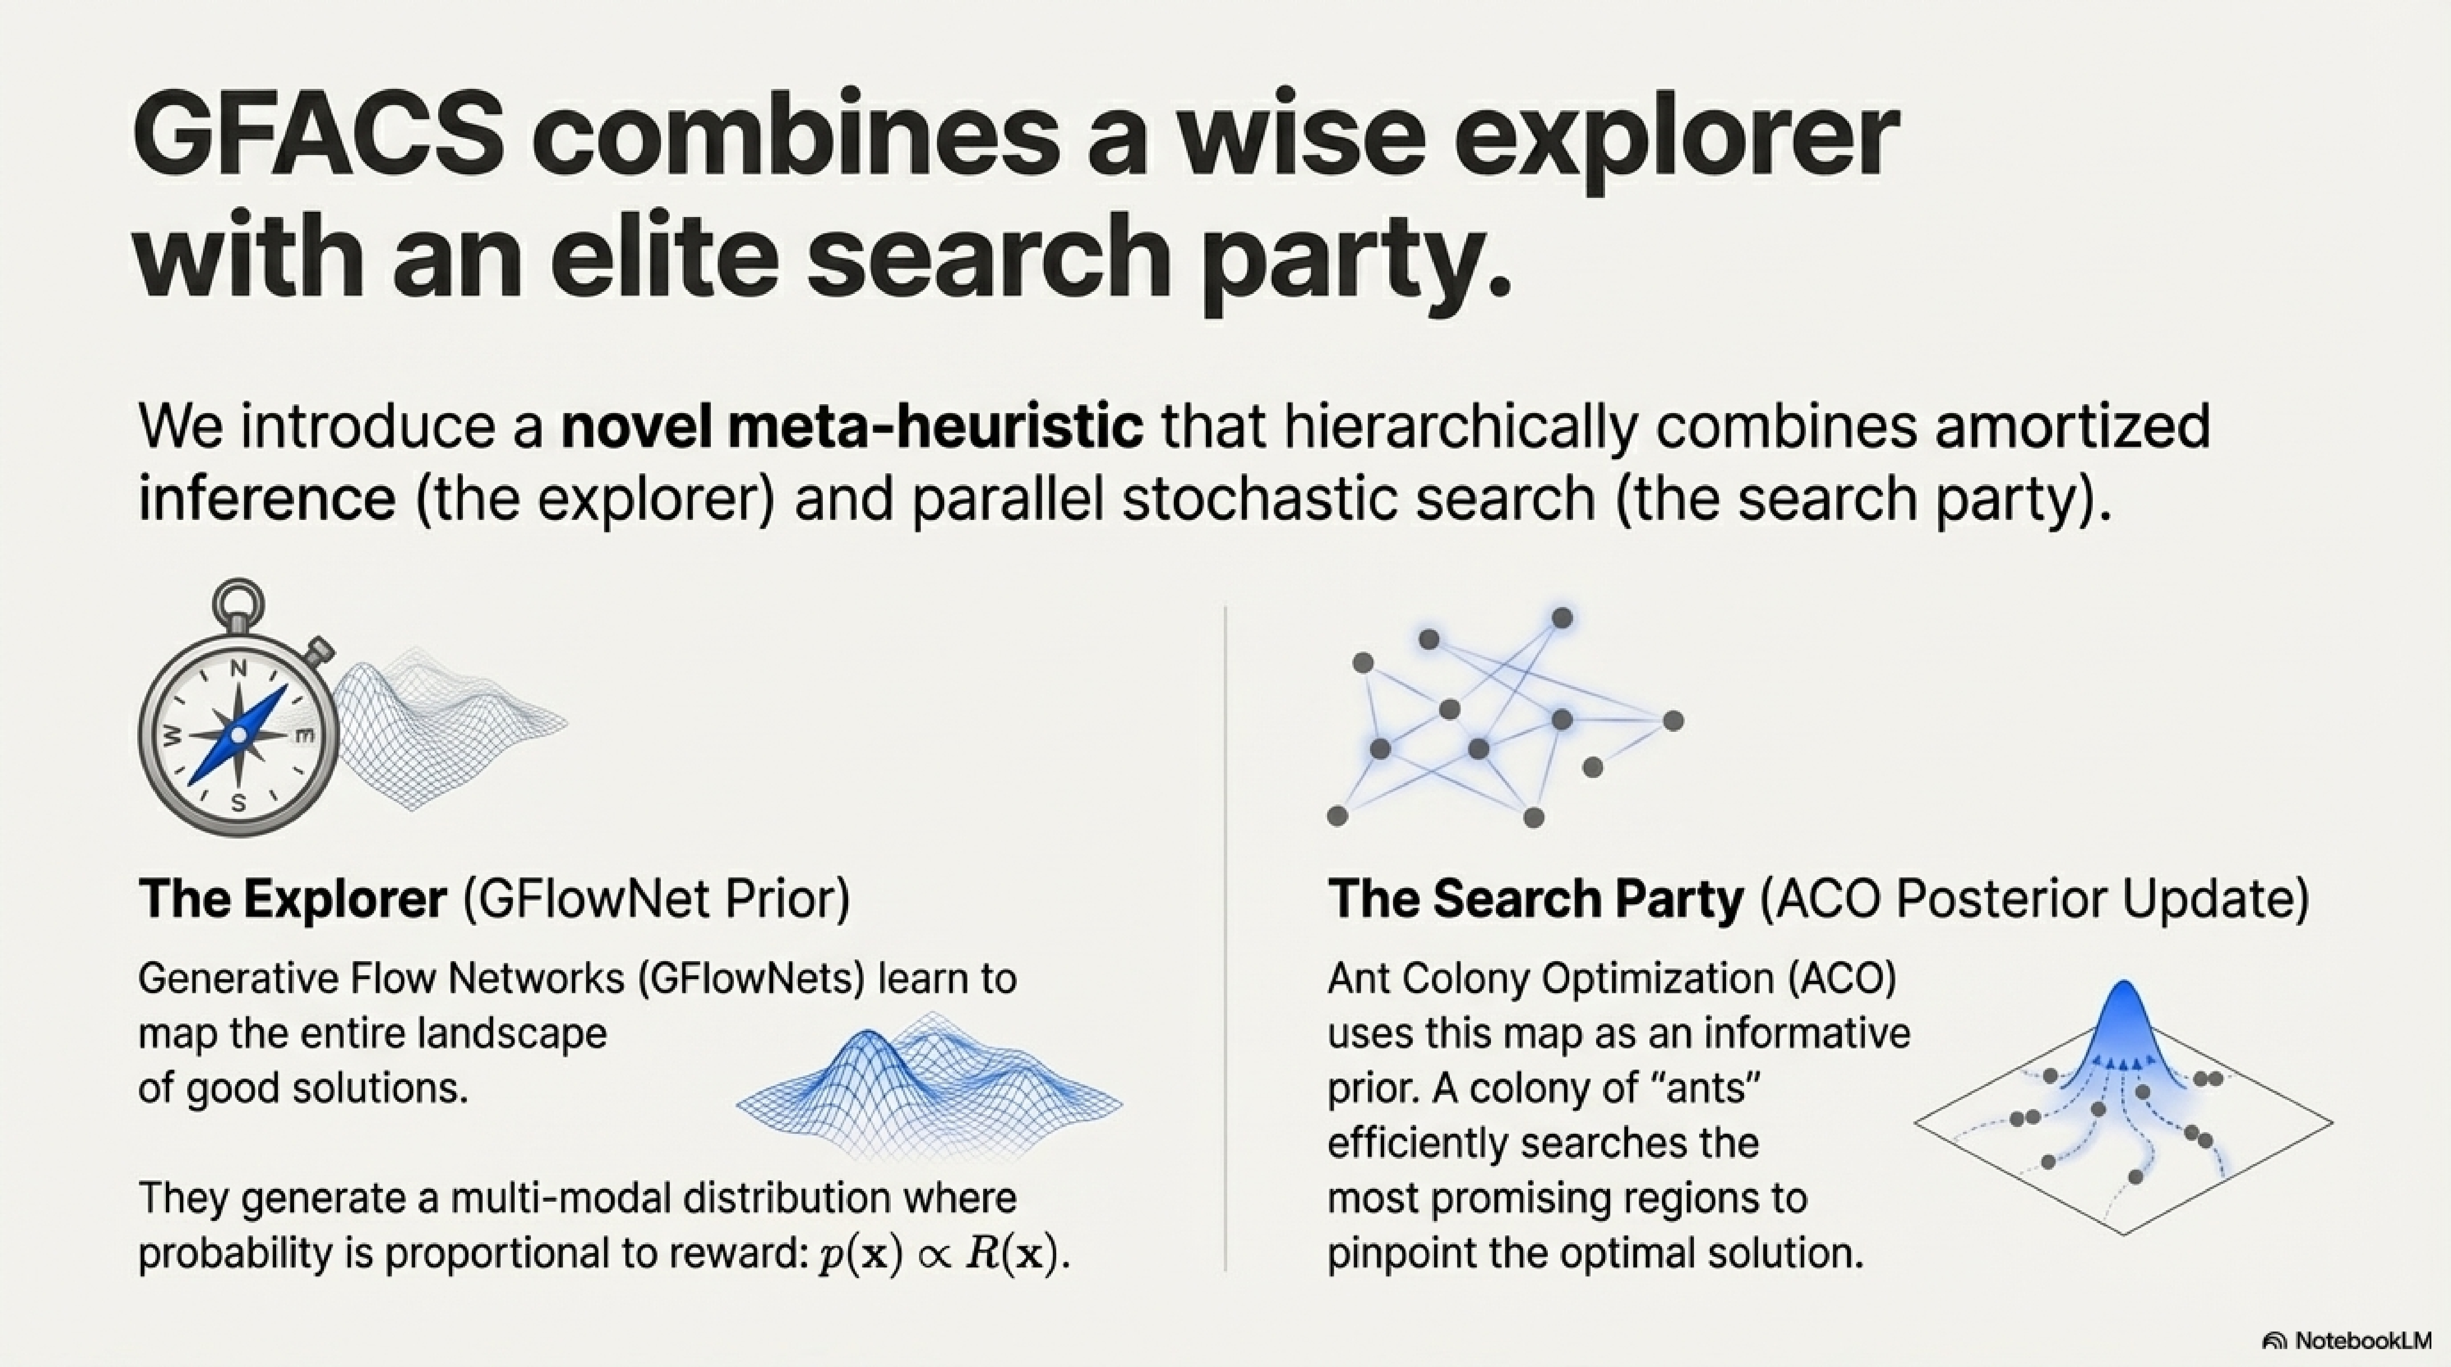

Slide 7
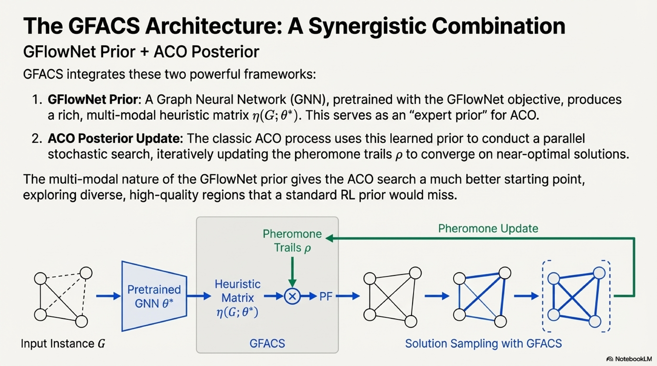

Slide 8
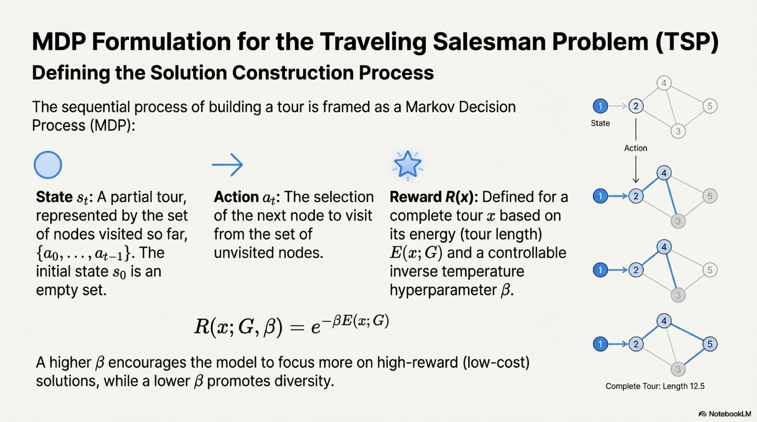

Slide 9
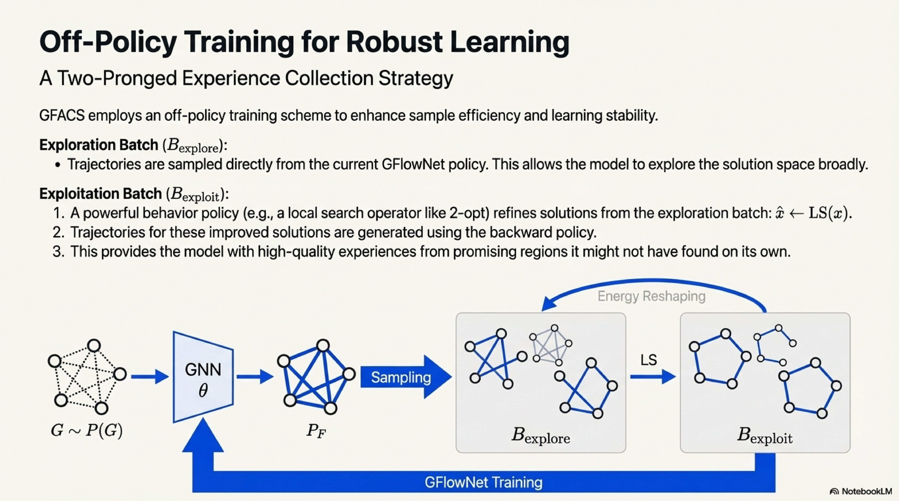

Slide 10
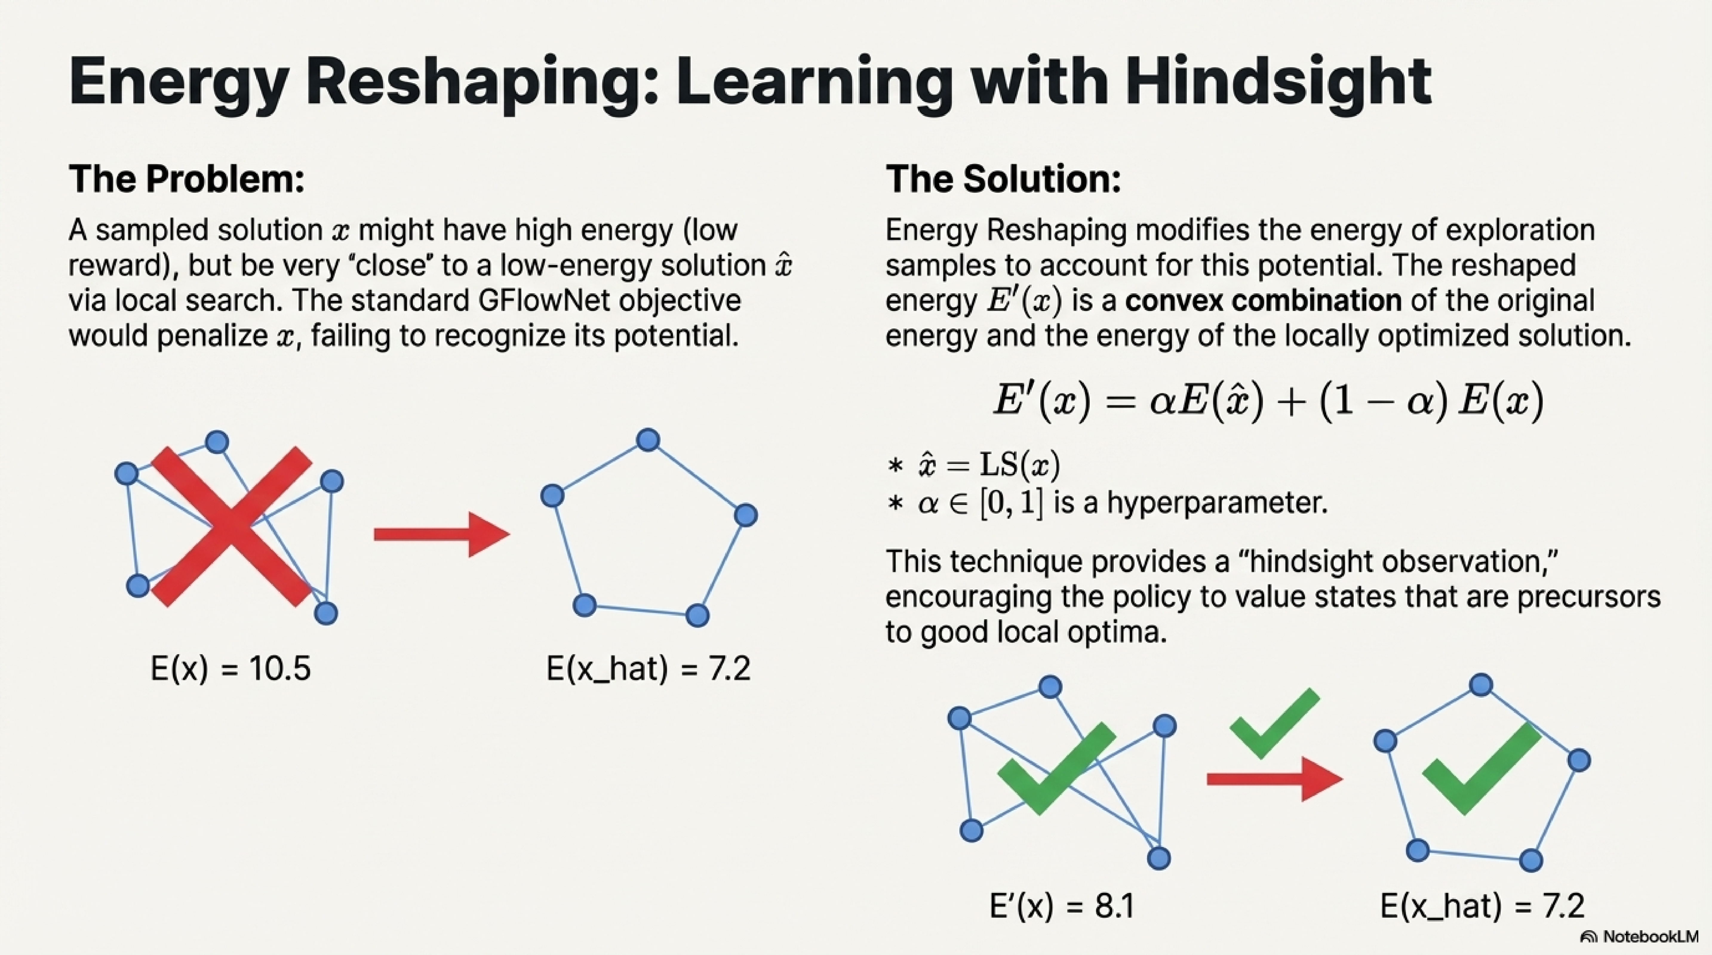

Slide 11
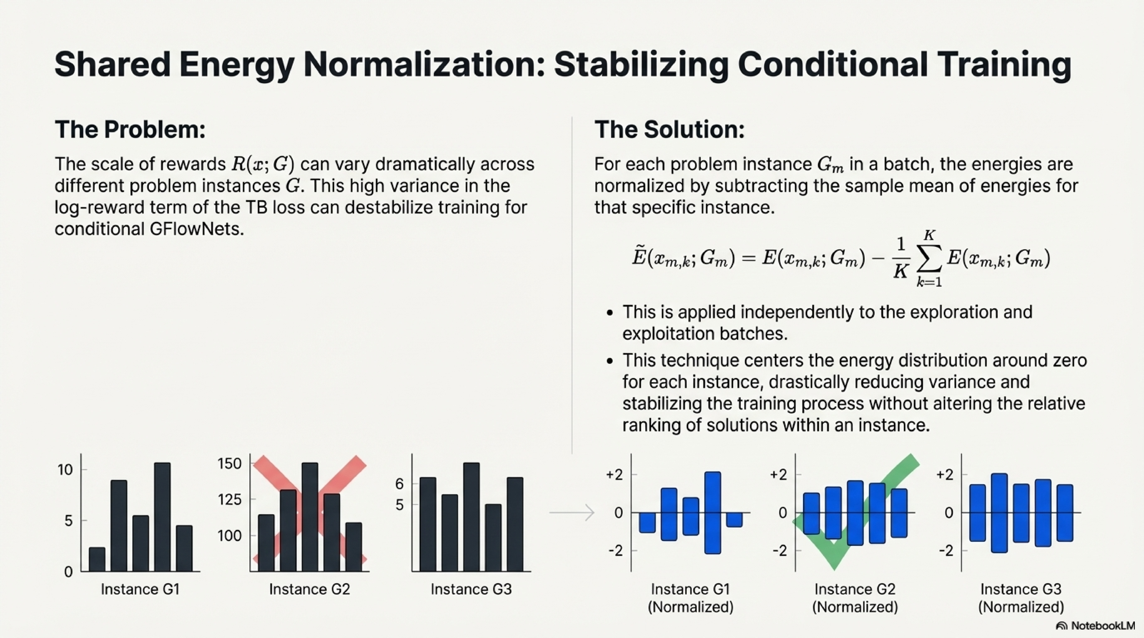

Slide 12
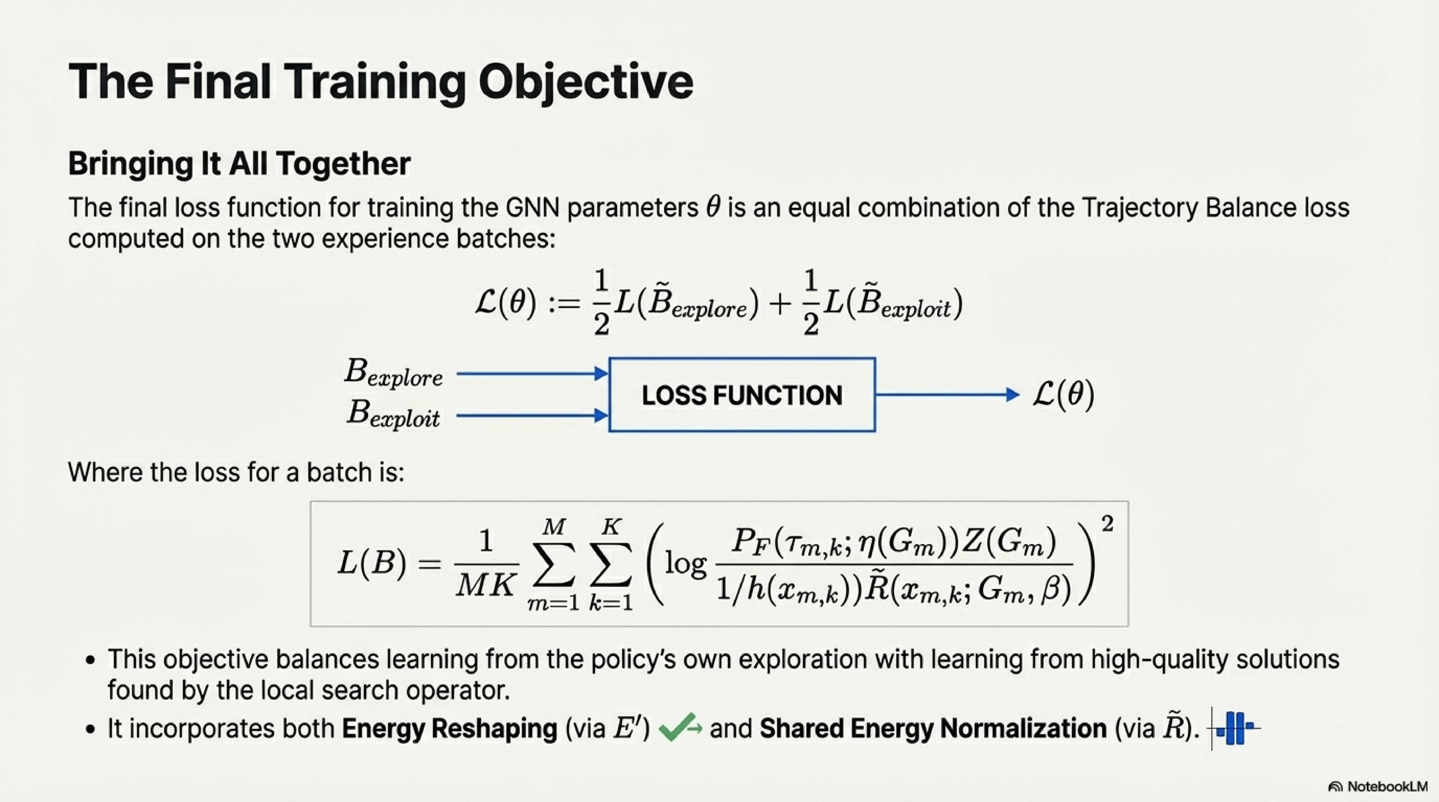

Slide 13
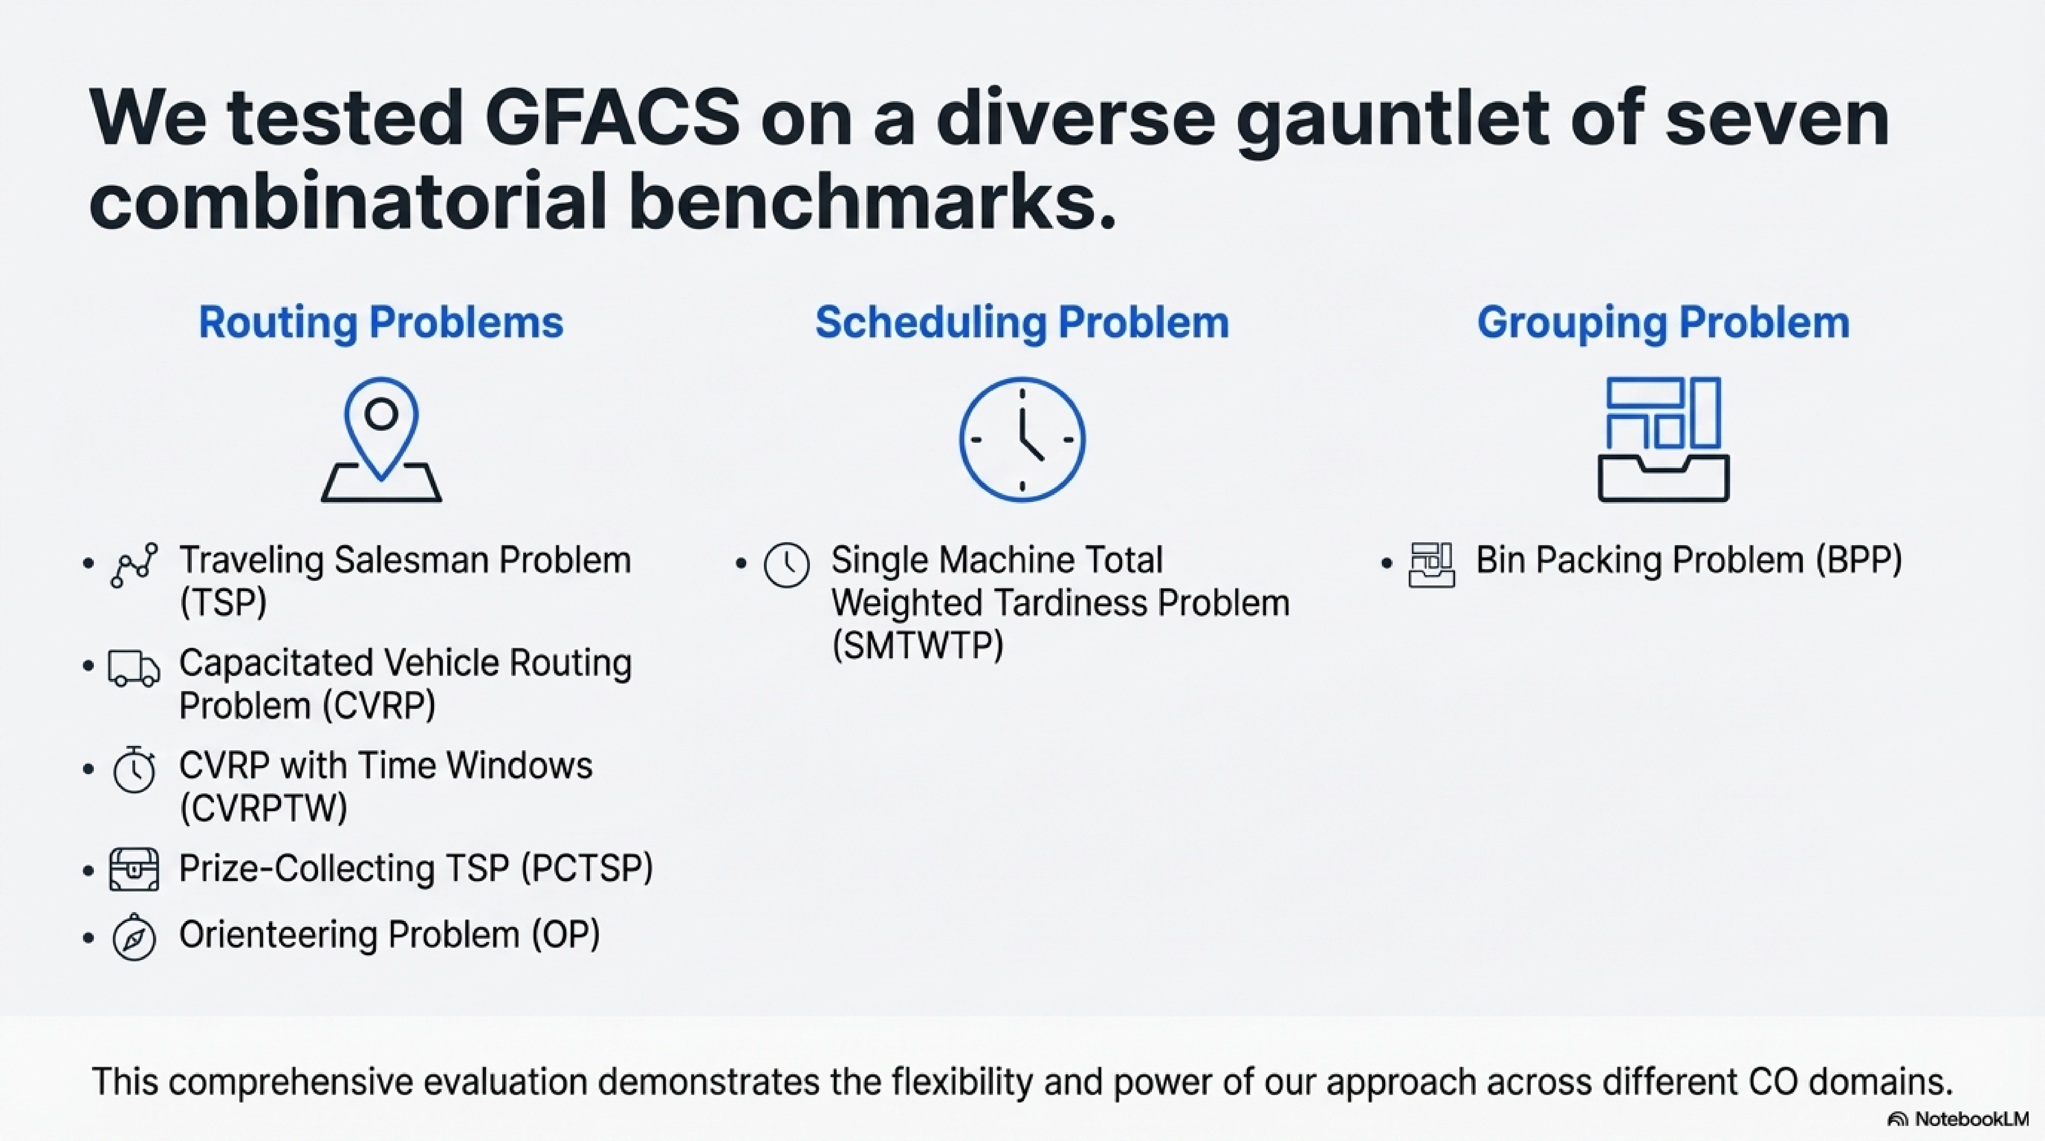

Slide 14
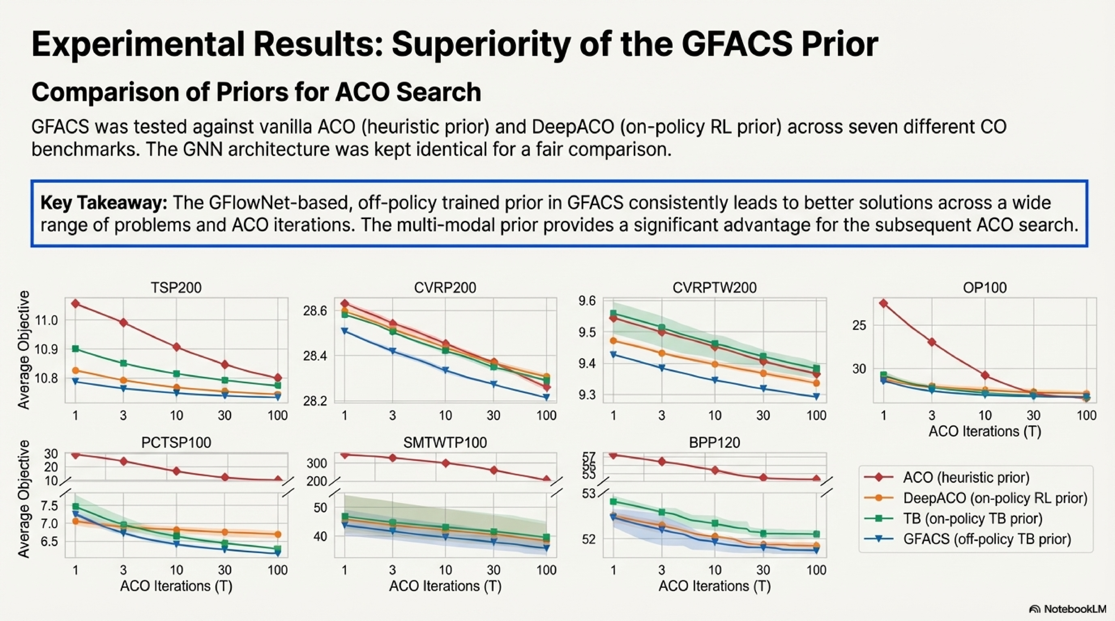

Slide 15
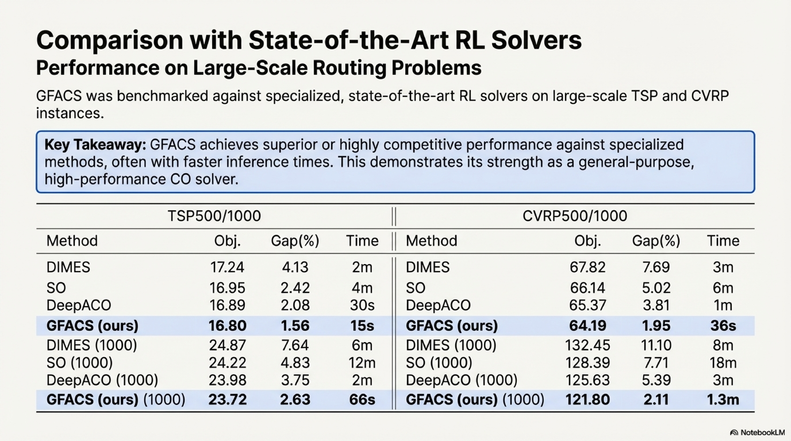

Slide 16
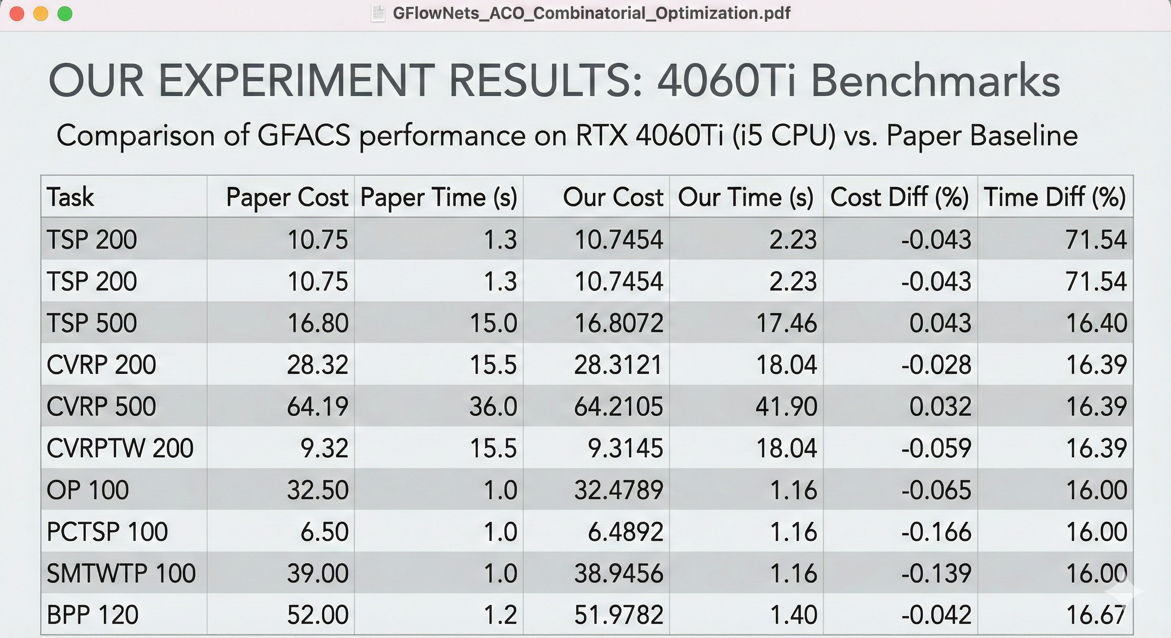

Slide 17
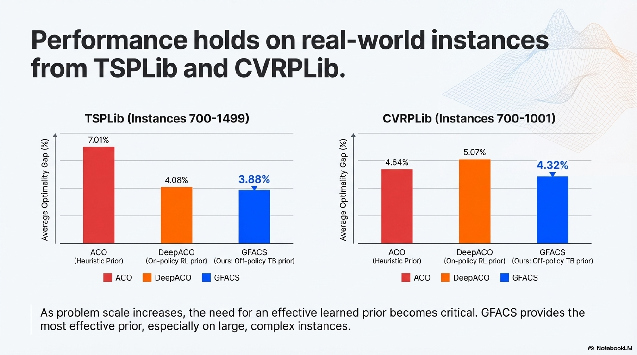

Slide 18
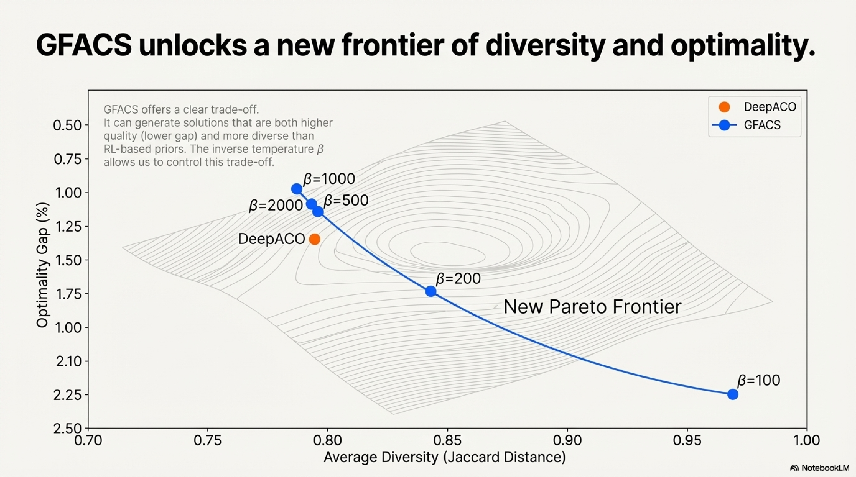

Slide 19
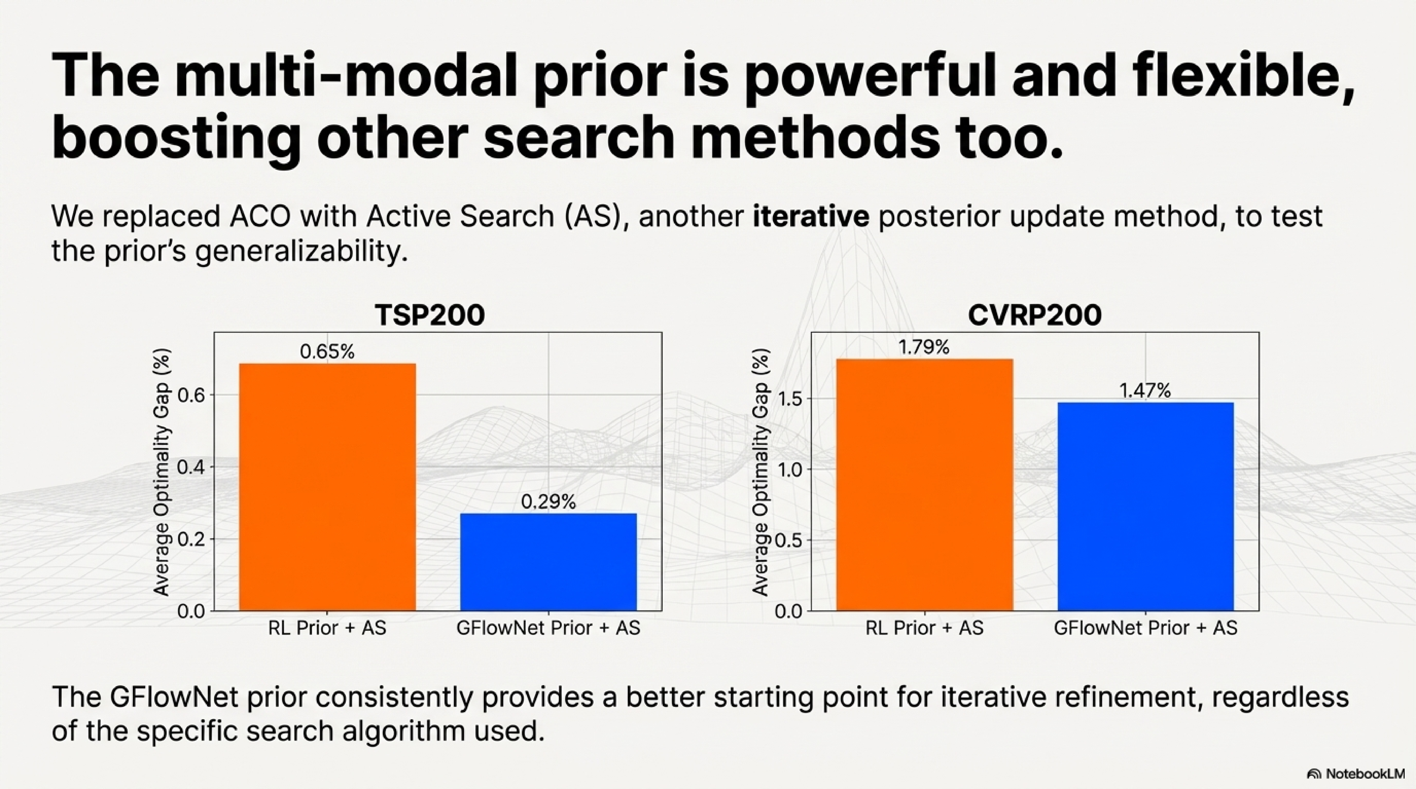

Slide 20
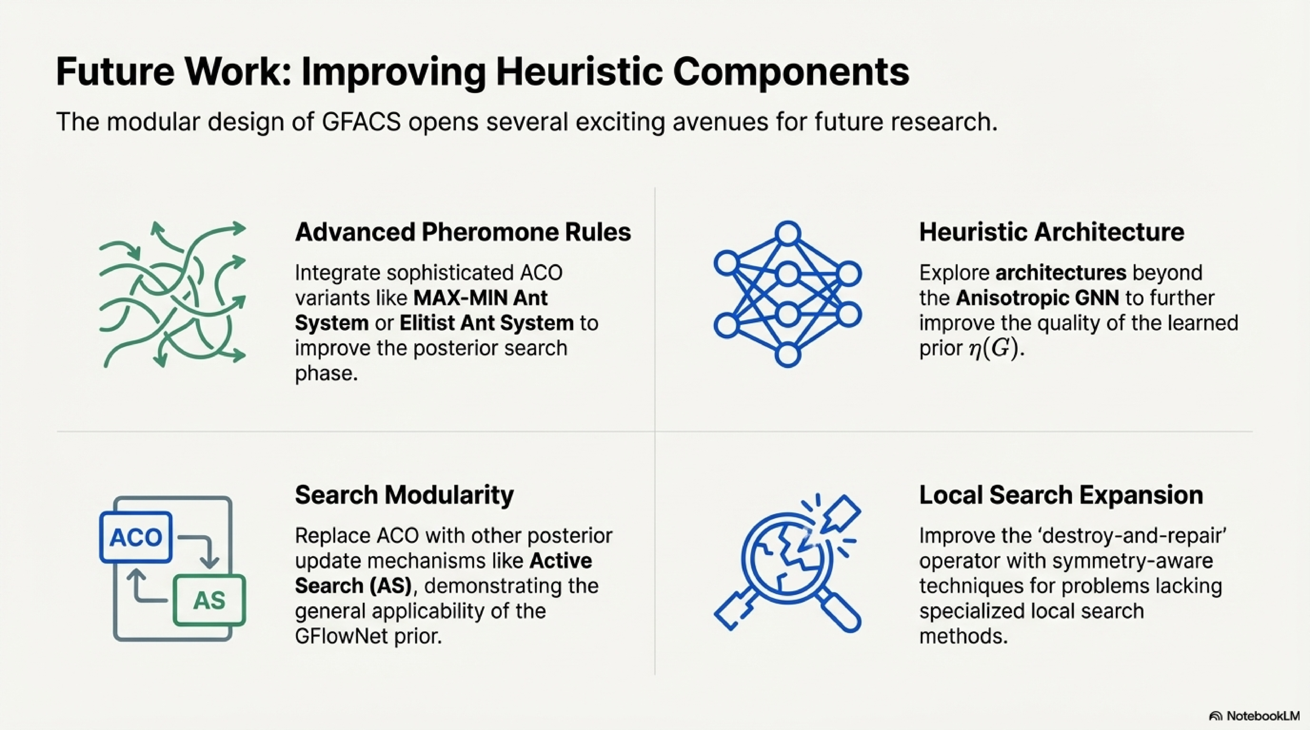

Slide 21
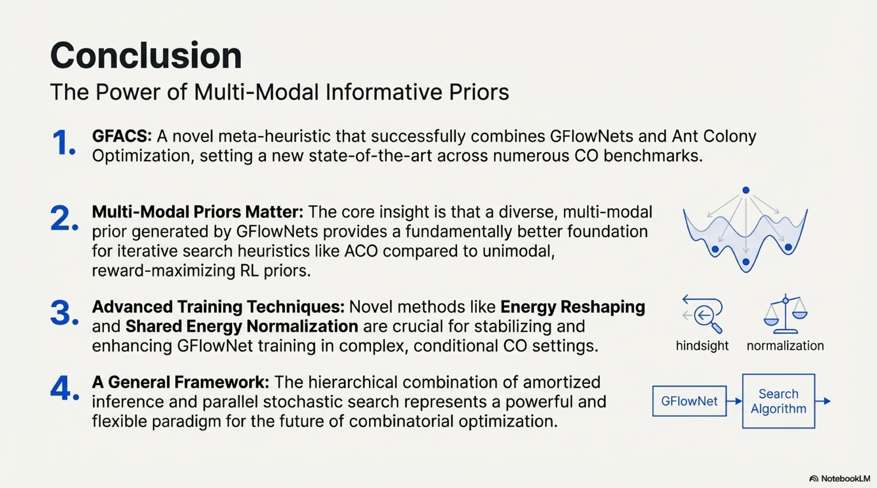

Slide 22
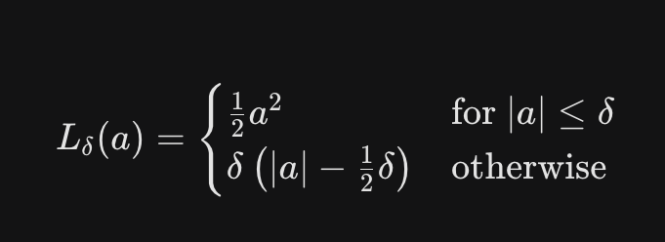
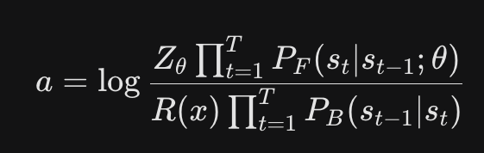
Improvements on Neural Network Architecture
Enhancing Structural Induction and Training Stability
From MLP to Gated Graph Convolutional Network (GatedGCN):
Replaced the paper's original MLP-based edge embedding with a GatedGCN to better capture the relational structure between items and bins.
Implemented an anisotropic message-passing mechanism to learn more nuanced constraints in Bin Packing Problem (BPP) instances.
Transition to Huber Loss for Flow Optimization:
Substituted the standard MSE loss used in the Trajectory Balance (TB) objective with Huber Loss.
Rationale: Huber loss provides inherent gradient clipping, stabilizing training against noisy advantage estimates and preventing the "training collapse" seen in complex combined models.
Refined Learning Dynamics: Maintains the paper's Shared Energy Normalization to center log-reward distributions while utilizing the more robust Huber loss for the final consistency objective.

Slide 23
Enhancements to Heuristic Search
Integrating Advanced ACO Variants and Hybrid Solvers
Max-Min Ant System (MMAS) Integration:
Advanced the paper's "vanilla" ACO posterior update by implementing MMAS pheromone clamping.
Restricts pheromones to [τmin​,τmax​] to ensure a "wise explorer" remains diverse and avoids the stagnation (mode collapse) typical of greedy RL priors.
Augmented Local Search (LS) Integration:
Expanded the Energy Reshaping concept: while the paper uses LS to define a convex combination of energies (E′) for training, we added a Swap/2-opt operator to the final inference phase.
This hybrid approach bridges the gap between global GFlowNet sampling and fine-grained local optimality.

Slide 24
Bin Packing Problem (BPP120) Results
Setup: N=120 items, U[20,100] size, Capacity 150.
Configuration | Metric (Avg Bins) | Gap (%) | Time (s) | Fitness
Baseline | 51.84 | 0% | - | 0.87
+Cost (Huber Loss) | 49.9 | -3.74% | ~705 | 0.96
+MMAS | 49.9 | -3.74% | ~706 | 0.96
+Local Search | 49.9 | -3.74% | ~718 | 0.98
+GatedGCN | 59.7 | +15.16% | ~699 | 0.79
Combined All | 118.7 | +128% | ~700 | 0.20

Slide 25
Traveling Salesman Problem (TSP200) Estimates
Setup: 200 nodes, U[0,1]2 coordinates.
Method | Objective (Length) | Gap (%)
Baseline (Paper) | 10.75 | 0.29%
+Cost / +MMAS / +LS | 10.74 | 0.15%
+Architecture | 10.77 | 0.50%
Combined | >12.0 | >10%
Traveling Salesman Problem (TSP500) Estimates
Setup: 500 nodes, Large-scale routing.
Method | Objective (Length) | Gap (%)
Baseline (Paper) | 16.80 | 1.56%
+Cost / +MMAS / +LS | 16.77 | 1.3 %
+Architecture | 16.87 | 2.00%
Combined | >20.0 | >20%

Slide 26
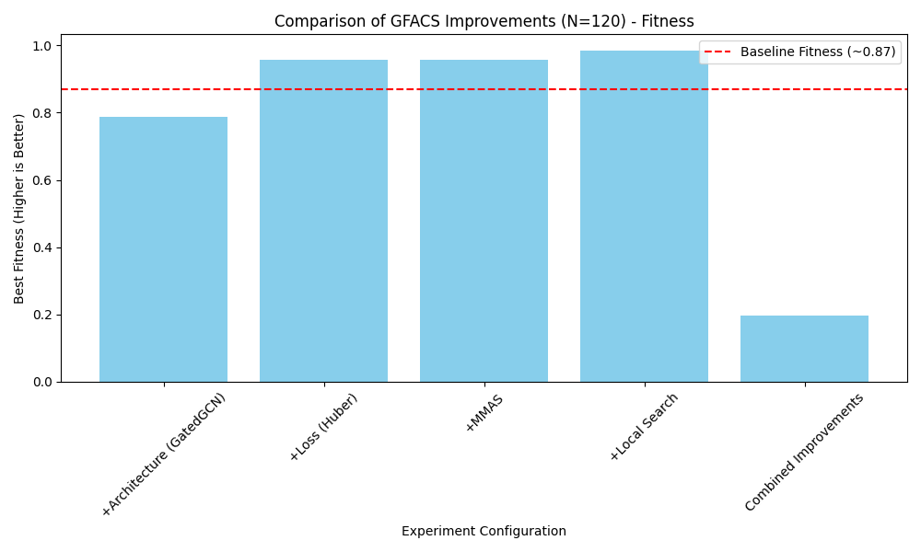

Slide 27
